Slide 1
Pharma: A Pharmacy Management System
Presented by Sworiya Shakya & Ritisha Shrestha

Slide 2
Table of content
Introduction_________________________________________ 1
Problem Statement___________________________________ 2
Objective___________________________________________ 3
Tools ______________________________________________ 4
Methodology________________________________________ 5
Functionality_________________________________________ 6
Architectural Design ___________________________________ 7

Slide 3

Introduction
Software used in a pharmacy that helps automate the pharmacy workflow
Keeps record of medications in the store, patients medicine history , bills calculation and medicine type.

Slide 4
Problem Statement
Misplacement of medicines
Improper record of medications
Miscalculation of medical bills

Slide 5
Objectives
To keep records of the medications in a systematic way.
To provide faster access of required medicine.
To resolve miscalculations in the billing department.

Slide 6
Tools used
Front end
Backend
Html
CSS
JavaScript
PHP
Database
Server
SQL
Apache

Slide 7
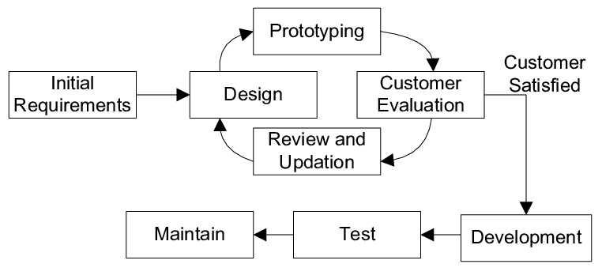
Methodology
Fig.Prototype model

Slide 8
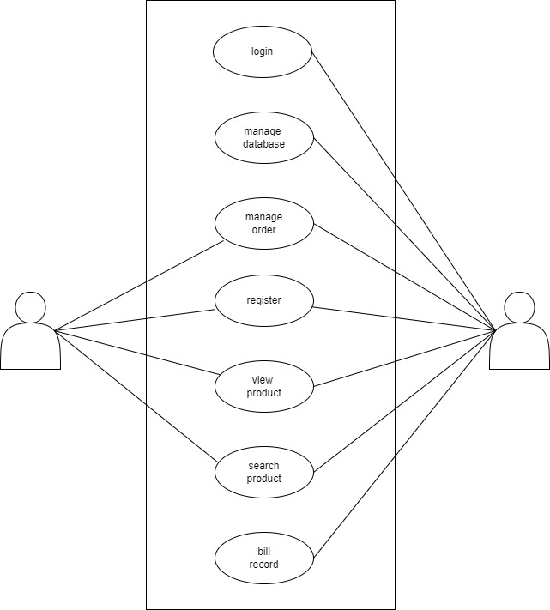

Functionality
user
admin

Slide 9
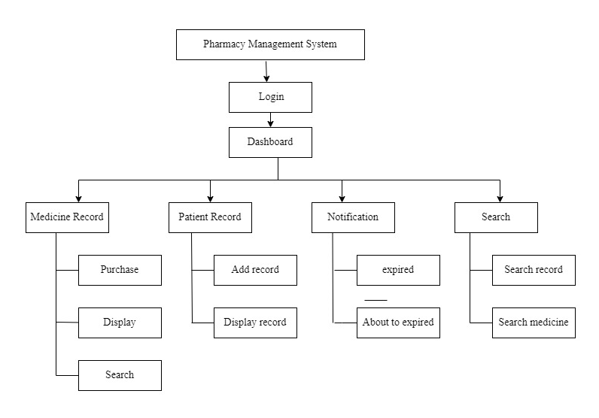
Architectural Design

Slide 10
Demo video

Slide 11
Thank you!

